Slide 1
Application Layer

Slide 2
Application Layer Protocols
An application layer protocol defines how an application processes (clients and servers) , running on different end systems, pass messages to each other.
In particular, an application layer protocol defines:
– The types of messages, e.g., request messages and response messages.
– The syntax of the various message types, i.e., the fields in the message and how the fields are delineated.
– The semantics of the fields, i.e., the meaning of the information that the field is supposed to contain;
– Rules for determining when and how a process sends messages and responds to messages.

Slide 3
TCP/IP Application Layer Protocols
The most widely known TCP/IP application layer protocols are those that provide the exchange of user information. These protocols specify the format and control information necessary for many of the common Internet communication functions.
Among these TCP/IP protocols are the following:
Domain Name System (DNS) is used to resolve Internet names to IP addresses.
Hypertext Transfer Protocol (HTTP) is used to transfer files that make up the web pages of the World Wide Web.

Slide 4
Simple Mail Transfer Protocol (SMTP) is used for the transfer of mail messages and attachments.
Telnet, a terminal emulation protocol, is used to provide remote access to servers and networking devices.
File Transfer Protocol (FTP) is used for interactive file transfer between systems.
The protocols in the TCP/IP suite are generally defined by Requests for Comments (RFC). The Internet Engineering Task Force (IETF) maintains the RFCs as the standards for the TCP/IP suite.

Slide 5
The World Wide Web (WWW):
HyperText Transfer Protocol (HTTP)
• The WWW was practically invented at CERN by Tim Berners-Lee and associates in 1989-1991 when initial versions of HTML, HTTP, a Web server and a crude text-based browser (Web client) were developed.
• Marc Andreeseen, who helped to develop the popular GUI browser Mosaic for X at The National Center for Supercomputing Applications (NCSA), released an alpha version of his browser in 1993, and in 1994 formed Mosaic Communications which later became Netscape.
•

Slide 6
The HyperText Transfer Protocol (HTTP) is the Web's main application-layer protocol
Like most application-layer protocols, HTTP is implemented in two programs:
A client program: Web browser and server program: Web server that talk to each other by exchanging HTTP messages.
HTTP defines the structure of these messages and how the client and server exchange the messages.
HTTP utilizes TCP connections to send client requests and server replies.

Slide 7
WWW Service and HTTP
When a web address (or URL) is typed into a web browser, the web browser establishes a connection to the web service running on the server using HTTP.
URLs and URIs (uniform resource identifiers) are the names most people associate with web addresses.
The URL http://www.nitt.edu /index.html refers to a specific resource—a web page named index.html on a server identified as nitt.edu.
Web browsers are the client applications computers use to connect to the World Wide Web and access resources stored on a web server.
As with most server processes, the web server runs as a background service and makes different types of files available.
To access the content, web clients make connections to the server and request the desired resources.
The server replies with the resources and, upon receipt, the browser interprets the data and presents it to the user.

Slide 9
Consider the URL - http://www.nitt.edu/web-server.htm.
First, the browser interprets the three parts of the URL:
http: The protocol or scheme
www.nitt.edu: The server name
web-server.htm: The specific filename requested
The browser then checks with a name server to convert http://www.nitt.edu into a numeric address, which it uses to connect to the server.
Using the HTTP requirements, the browser sends a GET request to the server and asks for the file web-server.htm.
The server in turn sends the HTML code for this web page to the browser.
Finally, the browser deciphers the HTML code and formats the page for the browser window.

Slide 10
HTTP, one of the protocols in the TCP/IP suite, was originally developed to publish and retrieve HTML pages and is now used for distributed, collaborative information systems.
HTTP is used across the world wide web for data transfer and is one of the most used application protocols.
HTTP specifies a request/response protocol.
When a client, typically a web browser, sends a request message to a server, the HTTP protocol defines the message types the client uses to request the web page and the message types the server uses to respond.

Slide 11
The three common message types are:
GET
POST
PUT
GET is a client request for data. A web browser sends the GET message to request pages from a web server.
POST and PUT are used to send messages that upload data to the web server.

Slide 12
HTTP is not a secure protocol. The POST messages upload information to the server in plain text that can be intercepted and read. Similarly, the server responses, typically HTML pages, are unencrypted.
For secure communication across the Internet, the Secure HTTP (HTTPS) protocol is used for accessing and posting web server information.
HTTPS can use authentication and encryption to secure data as it travels between the client and server.
HTTPS specifies additional rules for passing data between the application layer and the transport layer.

Slide 13
Uniform Resource Locators (URLs)
• Web browsers may utilize several high level protocols to request
data from a variety of servers in addition to HTTP servers.
• A uniform source locator (URL) specifies the following:
– Protocol used.
– Host name, alias, or IP address.
– Port number (if different from the default protocol port).
– Path to data requested.
– Resource requested (usually a file name).
• A few types of URLs:
http http://hostname:port/path/resource

Slide 14
DNS
The “Domain Name System”- Created in 1983 by Paul Mockapetris (RFCs 1034 and 1035), modified, updated, and enhanced
What Internet users use to reference anything by name on the Internet
An address is how you get to an endpoint
A “name” is how an endpoint is referenced
The mechanism by which Internet software translates names to attributes such as and vice versa

Slide 15
Domain Name System (DNS)
• DNS is a hierarchical system, based on a distributed database, that uses a hierarchy of Name Servers to resolve Internet host names into the corresponding IP addresses required for packet routing by issuing a DNS query to a name server.
• Name servers are usually Unix machines running the Berkeley Internet Name Domain (BIND) software.
• On many Unix-based machines using the sockets-API, gethostbyname() is the library routine that an application calls in order to issue a DNS query.

Slide 16
The DNS is also…
A lookup mechanism for translating objects into other objects
A globally distributed, loosely coherent, scalable, reliable, dynamic database
Comprised of three components
A “name space”
Servers making that name space available
Resolvers (clients) which query the servers about the name space
DNS provides the mapping between names and numbers

Slide 17
DNS as a Database
DNS is NOT a directory service
Keys to the database are “domain names”
Each domain name contains one or more attributes
Known as “resource records”
Each attribute individually retrievable

Slide 18
Global Distribution
Data is maintained locally, but retrievable globally
No single computer has all DNS data
DNS lookups can be performed by any device
Remote DNS data is locally cachable to improve performance

Slide 19
Loose Coherency
The database is always internally consistent
Each version of a subset of the database (a zone) has a serial number
The serial number is incremented on each database change
Changes to the master copy of the database are replicated according to timing set by the zone administrator
Cached data expires according to timeout set by zone administrator

Slide 20
Scalability
No limit to the size of the database
No limit to the number of queries
Tens of thousands of queries handled easily every second
Queries distributed among masters, slaves, and caches

Slide 21
Reliability
Data is replicated
Data from master is copied to multiple slaves
Clients can query
Master server
Any of the copies at slave servers
Clients will typically query local caches
DNS protocols can use either UDP or TCP
If UDP, DNS protocol handles retransmission, sequencing, etc.

Slide 22
Dynamicity
Database can be updated dynamically
Add/delete/modify of any record
Modification of the master database triggers replication
Only master can be dynamically updated
Creates a single point of failure

Slide 23
DNS Components
The name space
The servers
The resolvers

Slide 24
The Name Space
The name space is the structure of the DNS database
An inverted tree with the root node at the top
Each node has a label
The root node has a null label, written as “”

Slide 25
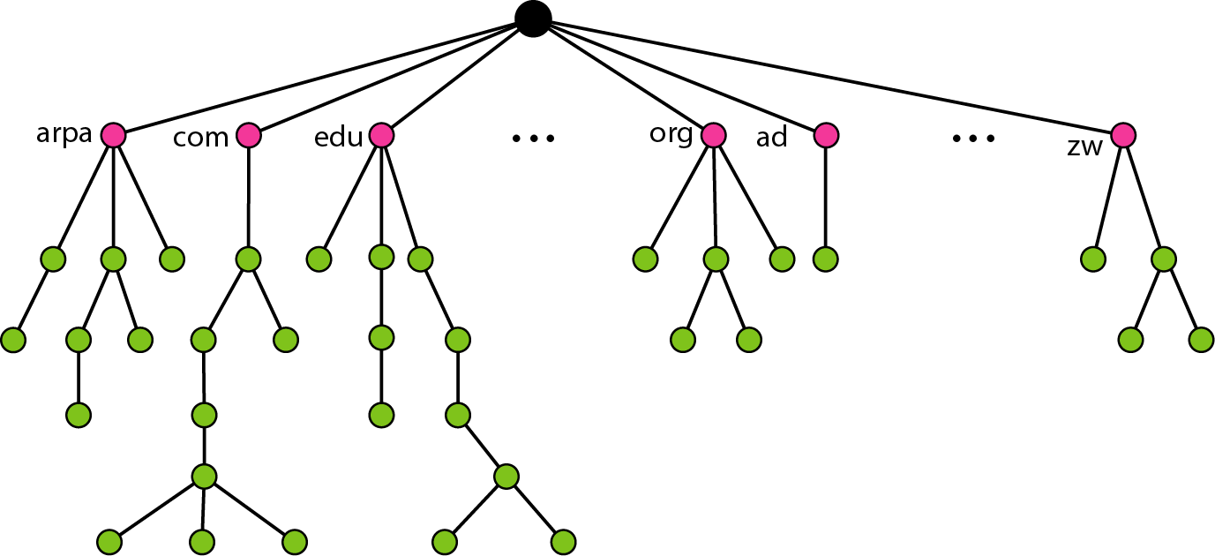
Domain name space

Slide 26
Labels
Each node in the tree must have a label
A string of up to 63 bytes
The DNS protocol makes NO limitation on what binary values are used in labels
RFCs 852 and 1123 define legal characters for “hostnames”
A-Z, 0-9, and “-” only with a-z and A-Z treated as the same
Sibling nodes must have unique labels
The null label is reserved for the root node

Slide 27
Domain Names
A domain name is the sequence of labels from a node to the root, separated by dots (“.”s), read left to right
The name space has a maximum depth of 127 levels
Domain names are limited to 255 characters in length
A node’s domain name identifies its position in the name space

Slide 28
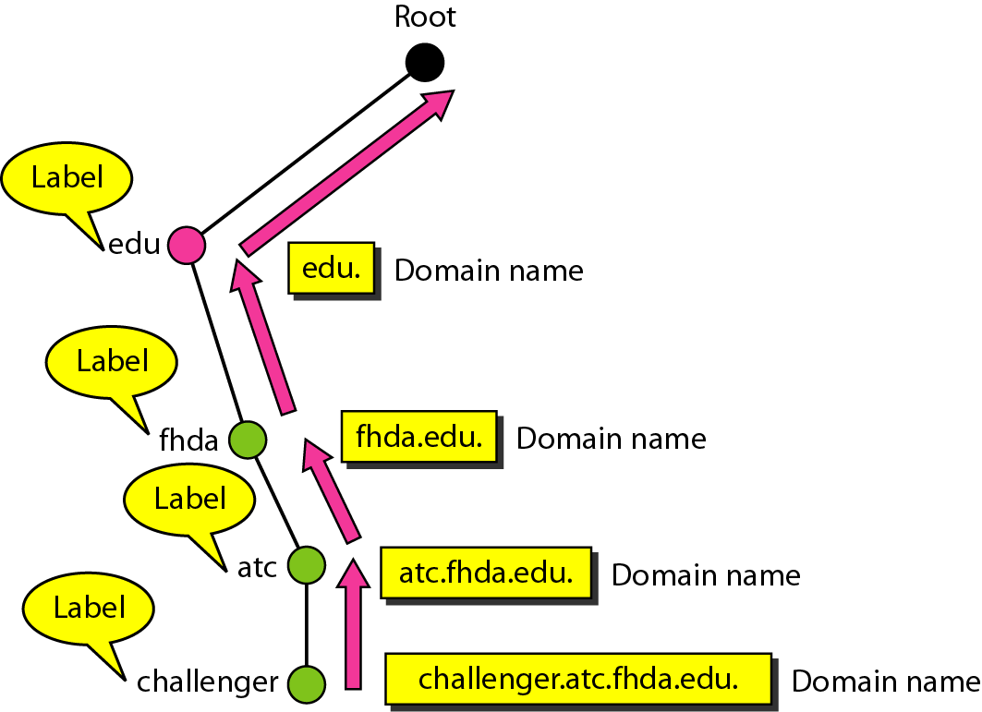
Domain names and labels

Slide 29
Subdomains
One domain is a subdomain of another if its domain name ends in the other’s domain name
So cse.nitt.edu is a subdomain of
nitt.edu & edu
nitt.edu is a subdomain of edu

Slide 30
Delegation
Administrators can create subdomains to group hosts
According to geography, organizational affiliation etc.
An administrator of a domain can delegate responsibility for managing a subdomain to someone else
The parent domain retains links to the delegated subdomains

Slide 31
Delegation Creates Zones
Each time an administrator delegates a subdomain, a new unit of administration is created
The subdomain and its parent domain can now be administered independently
These units are called zones
The boundary between zones is a point of delegation in the name space
Delegation is the key to scalability

Slide 32
Servers/Resolvers
Each host has a resolver
Typically a library that applications can link to
Local name servers hand-configured (e.g. /etc/resolv.conf)
Name servers
Either responsible for some zone or…
Local servers
Do lookup of distant host names for local hosts
Typically answer queries about local zone

Slide 33
Name Servers
Name servers store information about the name space in units called “zones”
The name servers that load a complete zone are said to “have authority for” or “be authoritative for” the zone
Usually, more than one name server are authoritative for the same zone
This ensures redundancy and spreads the load
Also, a single name server may be authoritative for many zones

Slide 34
Types of Name Servers
Two main types of servers
Authoritative – maintains the data
Master – where the data is edited
Slave – where data is replicated to
Caching – stores data obtained from an authoritative server
No special hardware necessary
Notes:
BIND: Berkeley Internet Name Domain

Slide 35
Name Server Architecture
Zone
data
file
Name Server Process
From
disk
Authoritative Data
(primary master and
slave zones)
Master
server
Zone transfer
Cache Data
(responses from
other name servers)
Agent
(looks up queries
on behalf of resolvers)

Slide 36
Authoritative Data
Name Server Process
Authoritative Data
(primary master and
slave zones)
Response
Cache Data
(responses from
other name servers)
Agent
(looks up queries
on behalf of resolvers)
Resolver
Query

Slide 37
Using Other Name Servers
Name Server Process
Authoritative Data
(primary master and
slave zones)
Cache Data
(responses from
other name servers)
Response
Response
Another
name
server
Agent
(looks up queries
on behalf of resolvers)
Query
Resolver
Query

Slide 38
Cached Data
Name Server Process
Authoritative Data
(primary master and
slave zones)
Response
Cache Data
(responses from
other name servers)
Agent
(looks up queries
on behalf of resolvers)
Query
Resolver

Slide 39
Name Resolution
A DNS query has three parameters:
A domain name (e.g., www.nitt.edu),
Remember, every node has a domain name!
A class (e.g., IN), and
A type (e.g., A)
Upon receiving a query from a resolver, a name server
1) looks for the answer in its authoritative data and its cache
2) If step 1 fails, the answer must be looked up

Slide 40
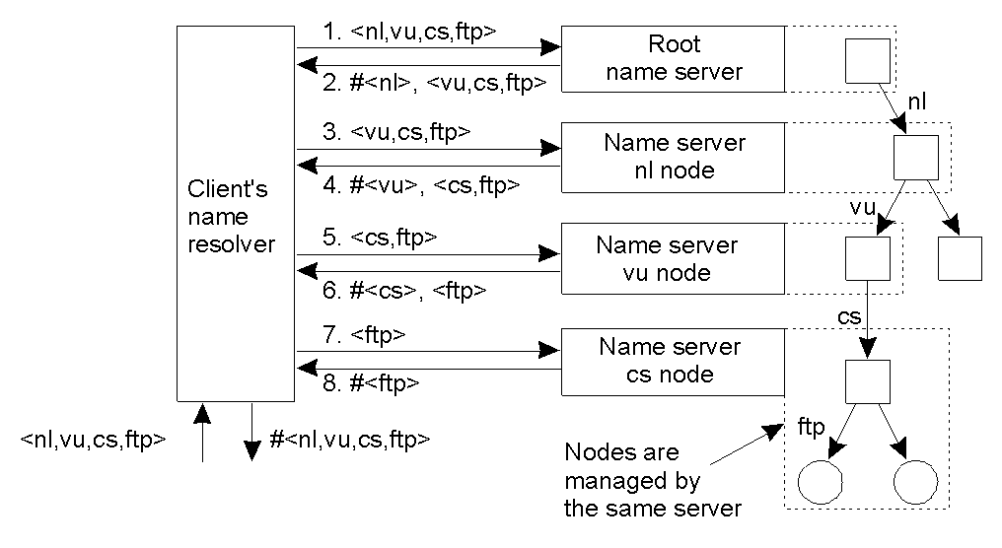
Iterative Name Resolution
The principle of iterative name resolution.

Slide 41
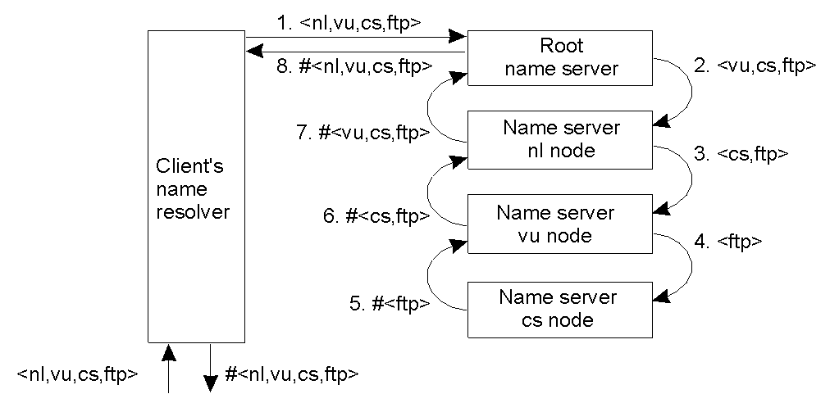
Recursive Name Resolution
The principle of recursive name resolution.

Slide 42
DNS Structure and Hierarchy
The DNS imposes no constraints on how the DNS hierarchy is implemented except:
A single root
The label restrictions
So, can we create a host with a name a.wonderful.world?
If a site is not connected to the Internet, it can use any domain hierarchy it chooses
Can make up whatever TLDs (top level domains) you want
Connecting to the Internet implies use of the existing DNS hierarchy

Slide 43
Root Name Servers
Responsible for “root” zone
Approx. 13 root name servers worldwide
Currently {a-m}.root-servers.net
Local name servers contact root servers when they cannot resolve a name
Configured with well-known root servers

Slide 44
Root Name Server Operators
Nameserver | Operated by:
A | Verisign (US East Coast)
B | University of S. California –Information Sciences Institute (US West Coast)
C | Cogent Communications (US East Coast)
D | University of Maryland (US East Coast)
E | NASA (Ames) (US West Coast)
F | Internet Software Consortium (US West Coast)
G | U. S. Dept. of Defense (ARL) (US East Coast)
H | U. S. Dept. of Defense (DISA) (US East Coast)
I | Autonomica (SE)
J | Verisign (US East Coast)
K | RIPE-NCC (UK)
L | ICANN (US West Coast)
M | WIDE (JP)

Slide 45
Simple Mail Transfer Protocol
Email is one of the oldest network applications
It is important
(1) to distinguish the user interface (i.e., your mail reader) from the underlying message transfer protocols (such as SMTP or IMAP), and
(2) to distinguish between this transfer protocol and a companion protocol (RFC 822 and MIME) that defines the format of the messages being exchanged

Slide 46
Simple Mail Transfer Protocol (SMTP), RFC 821
Sending Electronic Mail:
• SMTP transfers messages from senders' mail servers to the recipients' mail servers using TCP connections.
• SMTP existed long before it was fully specified by RFC 821 in 1982.
• Follows the client/server model:
– SMTP has two sides: a client side which executes on a sender's mail server, and server side which executes on recipient's mail server.
– Both the client and server sides of SMTP run on every mail server.
– When a mail server sends mail (to other mail servers), it acts as an SMTP client. When a mail server receives mail (from other mail servers) it acts as an SMTP server.

Slide 47
The process of sending a message:
– A user agent (mail reader) is used to create a message to be sent.
– The user agent directs the message to the outgoing message queue in the user's local mail server (acting as an SMTP client).
– The local mail server (SMTP client) opens a TCP connection directly to the remote destination SMTP mail server.
– After initial SMTP handshaking, the SMTP client sends the 7-bit ASCII encoded message into the TCP connection.
– The remote SMTP server receives the message over the TCP connection, closes the connection and places the message in the receipt's mailbox

Slide 48
Format of an e-mail
Mail is a Text File.
Envelope: It contains with sender address, receiver address and other information.
Message: It contains Mail Header and Mail Body.
Mail Header: It defines the sender, the receiver, the subject of the message and other information
Mail Body: It contains the actual information in the message

Slide 49
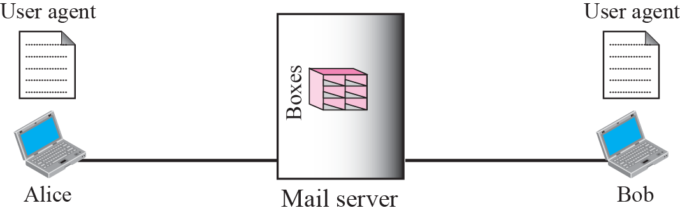
Email Architecture
First scenario
When the sender and the receiver of an e-mail are on the same mail server, we need only two user agents.

Slide 50
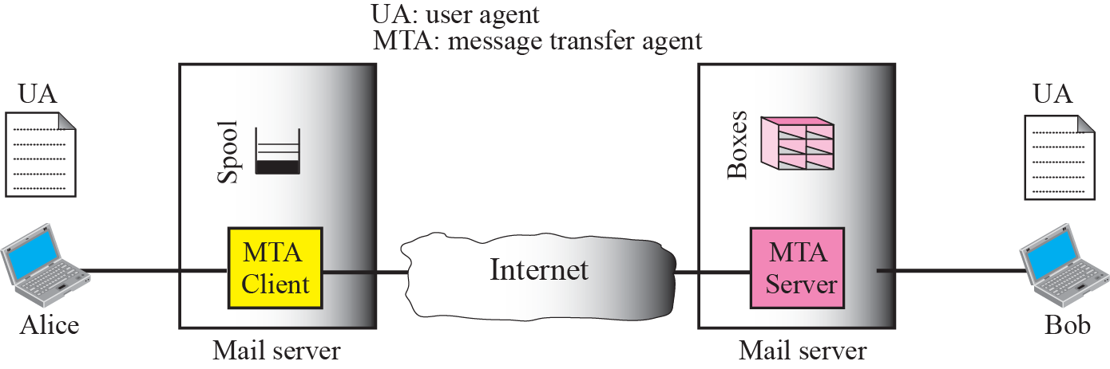
Second scenario
When the sender and the receiver of an e-mail are on different mail servers, we need two UAs and a pair of MTAs (client and server).

Slide 51
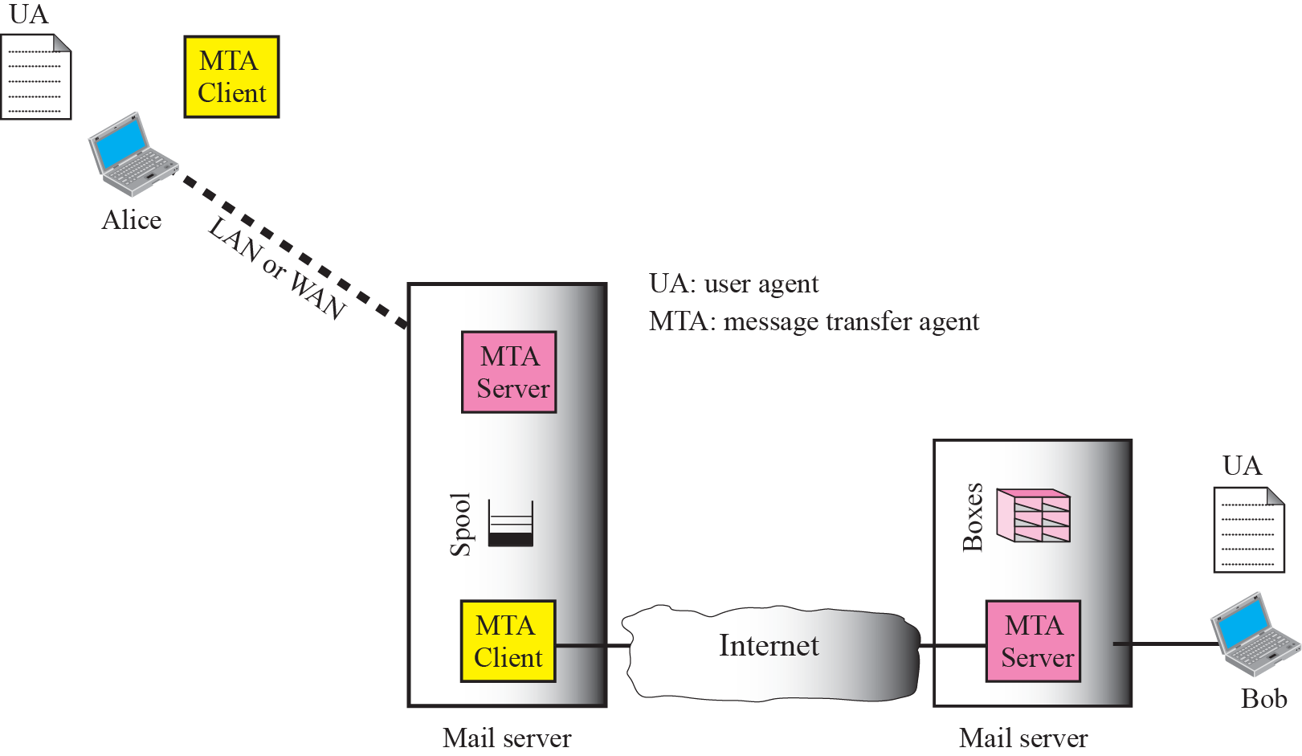
Third scenario
When the sender and the receiver of an e-mail are on the same mail server, we need only two user agents.

Slide 52
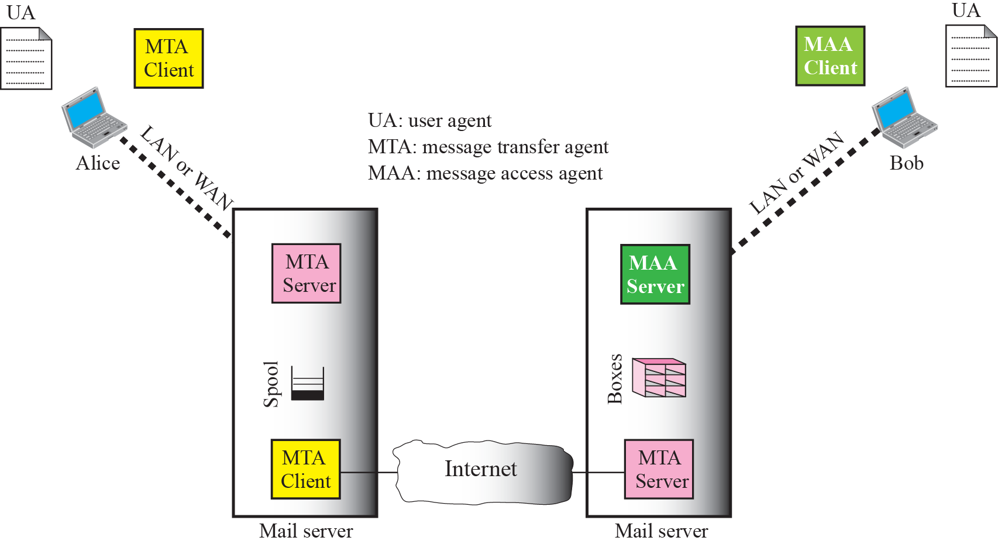

Fourth scenario
When both sender and receiver are connected to the mail server via a LAN or a WAN, we need two UAs, two pairs of MTAs (client and server), and a pair of MAAs (client and server). This is the most common situation today.

Slide 53

Electronic Mail
outgoing
message queue
user mailbox
Three major components:
user agents
mail servers
Simple Mail Transfer Protocol: SMTP used to exchange electronic mail.
User Agent (Email Reader)
a.k.a. “mail reader”
composing, editing, reading mail messages
e.g., Eudora, Outlook, elm, Netscape Messenger
outgoing, incoming messages stored on server
user
agent
mail
server
user
agent
SMTP
mail
server
user
agent
SMTP
SMTP
mail
server
user
agent
user
agent
user
agent

Slide 54
Electronic Mail: mail servers
Mail Servers
mailbox contains incoming messages for user
message queue of outgoing (to be sent) mail messages
SMTP protocol between mail servers to send email messages
client: sending mail server
“server”: receiving mail server
user
agent
mail
server
user
agent
SMTP
mail
server
user
agent
SMTP
SMTP
mail
server
user
agent
user
agent
user
agent

Slide 55


Scenario: Alice sends message to Bob
1) Alice uses Email Reader to compose message and “to” bob@bilkent.edu.tr
2) Alice’s UA sends message to her mail server; message placed in message queue
3) Client side of SMTP opens TCP connection with Bob’s mail server
4) SMTP client sends Alice’s message over the TCP connection
5) Bob’s mail server places the message in Bob’s mailbox
6) Bob invokes his user agent to read message
Alice
Bob
1
mail
server
mail
server
user
agent
user
agent
2
3
6
4
5

Slide 56
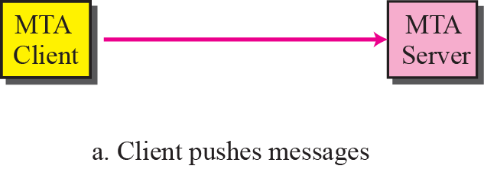
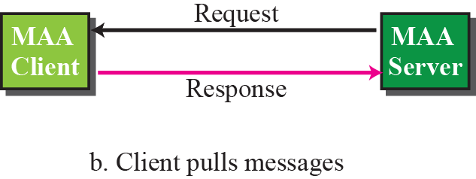
Push versus pull

Slide 57

Mail access protocols
SMTP
SMTP
access
protocol
Email
Readee
Email Reader
sender’s mail
server
receiver’s mail
server
SMTP: delivery/storage to receiver’s server
Mail access protocol: retrieval from server
POP: Post Office Protocol [RFC 1939]
authorization (agent <-->server) and download
IMAP: Internet Mail Access Protocol [RFC 1730]
more features (more complex)
manipulation of stored messages on server
HTTP: Hotmail , Yahoo! Mail, etc.

Slide 58
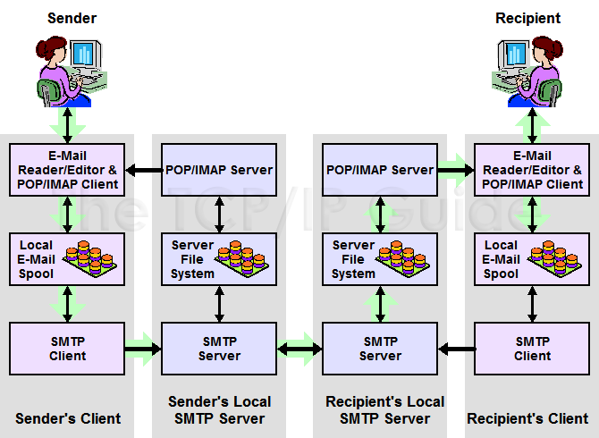
SMTP Communication Model

Slide 59
Electronic Mail: SMTP [RFC 2821]
uses TCP to reliably transfer email message from client to server, port 25
uses persistent connections
direct transfer: sending server to receiving server
three phases of transfer
handshaking (greeting)
transfer of messages
closure
command/response interaction
commands: ASCII text (HELO, MAIL FROM, etc.)
response: status code and phrase
messages must be in 7-bit ASCII
requires message (header & body) to be in 7-bit ASCII
SMTP server uses CRLF.CRLF to determine end of message

Slide 60
Message Format
RFC 822 defines messages to have two parts: a header and a body. Both parts are represented in ASCII text.
Originally, the body was assumed to be simple text. This is still the case, although RFC 822 has been augmented by MIME to allow the message body to carry all sorts of data.
This data is still represented as ASCII text, but because it may be an encoded version of, say, a JPEG image, it’s not necessarily readable by human users.
The message header is a series of <CRLF>-terminated lines. (<CRLF> stands for carriage-return+ line-feed, which are a pair of ASCII control characters often used to indicate the end of a line of text.)

Slide 61
The header is separated from the message body by a blank line. Each header line contains a type and value separated by a colon.
Many of these header lines are familiar to users since they are asked to fill them out when they compose an email message.
RFC 822 was extended in 1993 (and updated quite a few times since then) to allow email messages to carry many different types of data: audio, video, images, PDF documents, and so on.

Slide 62
Multipurpose Internet Mail Extensions (MIME)
• SMTP can only handle ASCII-encoded messages, hence binary data is first encoded to ASCII in such a way that certain ASCII characters (including ".") are not used, using base64 encoding for example.
• If binary data is included in a message, MIME headers are used to inform the receiving mail agent:
– Content-Transfer-Encoding: header. Alerts the receiving user agent that the message body has been ASCII encoded and the type of encoding used.
– Content-Type: header. Informs the receiving mail agent about the type of data included in the message. e.g. text - text/plain; Jpeg - image/jpeg; MPEG- video/mpeg

Slide 63
Multipurpose Internet Mail Extensions (MIME)
MIME consists of three basic pieces.
The first piece is a collection of header lines that augment the original set defined by RFC 822. These header lines describe, in various ways, the data being carried in the message body. They include MIME-Version: (the version of MIME being used), Content-Description: (a human-readable description of what’s in the message, analogous to the Subject: line), Content-Type: (the type of data contained in the message), and Content-Transfer- Encoding (how the data in the message body is encoded).
The second piece is definitions for a set of content types (and subtypes). For example, MIME defines two different still image types, denoted image/gif and image/jpeg, each with the obvious meaning.
The third piece is a way to encode the various data types so they can be shipped in an ASCII email message.

Slide 64
Message Transfer
For many years, the majority of email was moved from host to host using only SMTP.
While SMTP continues to play a central role, it is now just one email protocol of several, IMAP and POP being two other important protocols for retrieving mail messages.
Key players in SMTP
First, users interact with a mail reader when they compose, file, search, and read their email.

Slide 65
Second, there is a mail daemon (or process) running on each host that holds a mailbox.
This process, also called a message transfer agent (MTA), as playing the role of a post office: users (or their mail readers) give the daemon messages they want to send to other users, the daemon uses SMTP running over TCP to transmit the message to a daemon running on another machine, and the daemon puts incoming messages into the user’s mailbox (where that user’s mail reader can later find it).

Slide 66
While it is certainly possible that the MTA on a sender’s machine establishes an SMTP/TCP connection to the MTA on the recipient’s mail server, in many cases the mail traverses one or more mail gateways on its route from the sender’s host to the receiver’s host.
Like the end hosts, these gateways also run a message transfer agent process.

Slide 67
Mail Reader
The final step is for the user to actually retrieve his or her messages from the mailbox, read them, reply to them, and possibly save a copy for future reference.
The user performs all these actions by interacting with a mail reader.
This reader was originally just a program running on the same machine as the user’s mailbox, in which case it could simply read and write the file that implements the mailbox. This was the common case in the pre-laptop era.
Today, most often the user accesses his or her mailbox from a remote machine using yet another protocol, such as the Post Office Protocol (POP) or the Internet Message Access Protocol (IMAP).

Slide 68
IMAP is similar to SMTP in many ways.
It is a client/server protocol running over TCP, where the client (running on the user’s desktop machine) issues commands in the form of <CRLF>-terminated ASCII text lines and the mail server (running on the machine that maintains the user’s mailbox) responds in-kind.
The exchange begins with the client authenticating him or herself, and identifying the mailbox he or she wants to access.

Slide 69
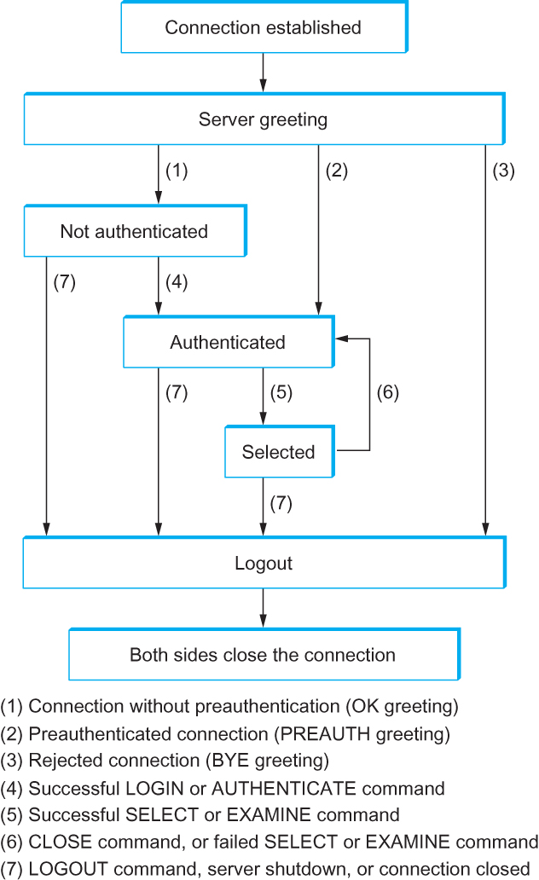
IMAP State Transition Diagram

